Slide 1
Are you paying the right price for your property?
Predictive analysis of property prices in king county, usa.
Project by - Mihir Gandhi | gandhi.mih@husky.neu.edu
NORTHEASTERN UNIVERSITY
ALY6040 – DATA MINING APPLICATIONS
INSTRUCTOR – JUSTIN GROSZ

Slide 2
Objective of the project
Create a predictive model to predict the price of houses in King County, USA
Provide a tool for potential buyers to safeguard themselves from the inflated price of property set by local realtors and management companies
Aid the sellers to set an accurate price for their property
Observe differences between different statistical models
Provide a base for creating a predictive model for other areas

Slide 3
Summary
What is the Dataset?
Data Cleaning Techniques
Correlation Matrix
Linear Modelling
Optimized Linear Model
Stepwise Regression and Gradient Boosting Model
Conclusion

Slide 4
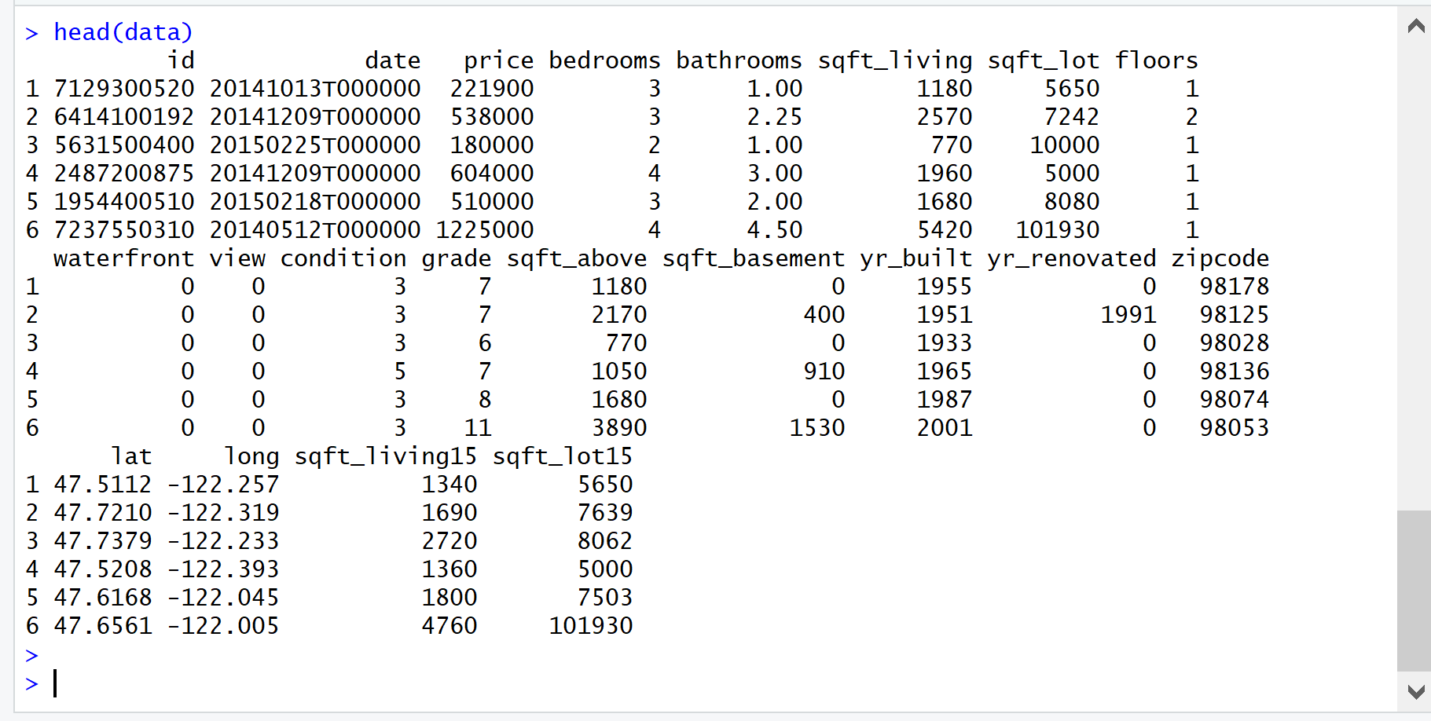
What is the dataset?
Historical property sale records of each property in King County, USA.
Total Entries: 21613 observations
No. of Variables : 21 (19 parameters of the property, id and date)
Sample data set:

Slide 5
Data cleaning techniques
Missing and NA Values
No NA values present in the dataset. Checked by [is.na] function
No missing values present. Checked for [blanks] in Excel
Typos
Outlier found in “bedrooms” was 33.
Converted 33 to 3 and added to the dataset.
Outliers
Outliers checked with the help of boxplots
Variables group as per the range of values
No outliers were removed due to closeness to the cluster
Checking with corresponding row assumed as a typo.

Slide 6
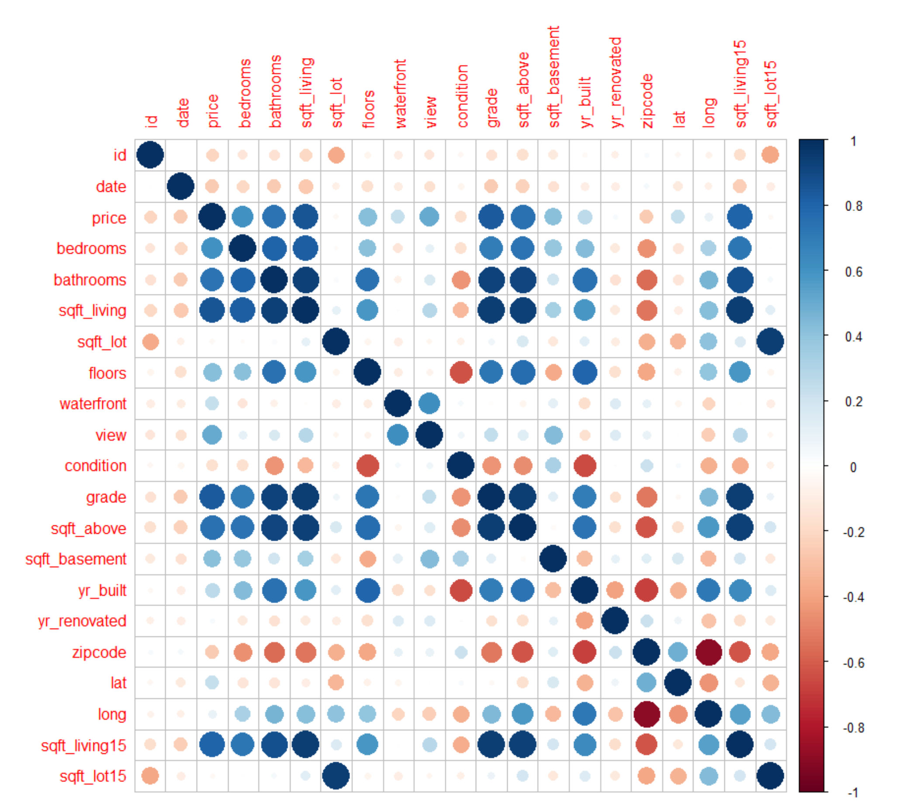
Correlation matrix

Slide 7
Linear modelling [1]
Linear model created with 14 variables.
Train set:
17,290 observations
R2 value : 70.12
P-value : < 2.2e-16
Significant variables:
[grade, lat, view]
No overfitting as all VIF
values below 10
Test data set
4,323 observations
R2 value : 69.21
P-value : <2.2e-16
Significant variables
[lat, view, condition]
- No overfitting as all VIF values below 10

Slide 8
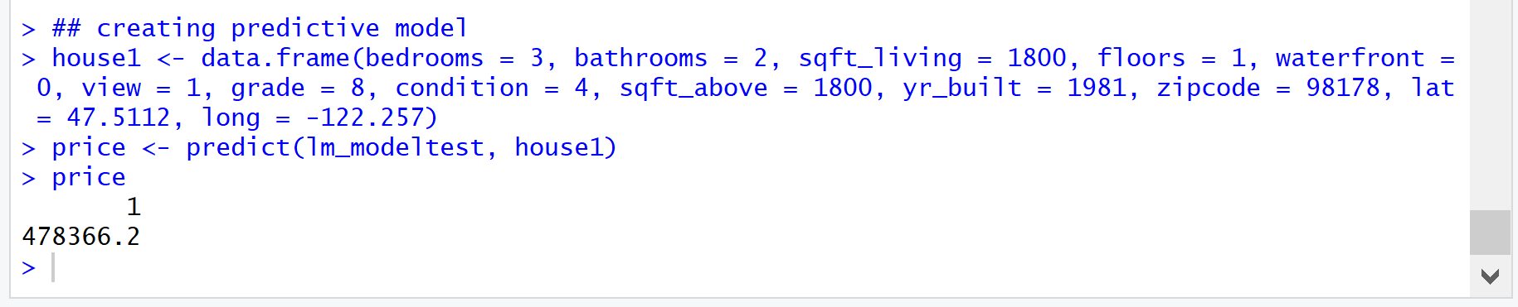
Linear modelling [2]
P-value of floors for both data sets high, plan to drop in optimized model.
Predictive Model created for 69.21% accuracy
Predicted value for house : $478,366.2

Slide 9
Optimized linear model [1]
Applied logarithmic transformation for normal distribution
Removed “floors” variable from the data set
Train set:
17,290 observations
R2 value : 76.27
P-value : < 2.2e-16
No overfitting as all VIF values below 10
Test data set
4,323 observations
R2 value : 75.72
P-value : <2.2e-16
- No overfitting as all VIF values below 10

Slide 10
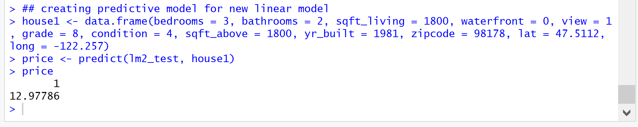
Optimized linear model [2]
Predictive model created for 75.72% accuracy (6.5% higher than previous model)
Antilog value of 12.97786
Logarithmic equivalent - 432,726
Difference of $45,640.2 than the previous model

Slide 11
Stepwise regression and gradient boosting model [1]
Stepwise Regression
Backward stepwise regression performed for removing unwanted variables
All variables were found significant to the model
Gradient Boosting Model
Training Model
Iteration level set at 10,000
Maximum relative influence – Latitude
Minimum relative influence – Bedrooms
Optimal number of iterations for minimum squared error loss – 2,744, prevents overfitting
Predicted values of price based on 2,744, means of predicted and original almost equal

Slide 12
Stepwise regression and gradient boosting model [2]
Test Model
Iteration level set at 10,000
Maximum relative influence – Latitude
Minimum relative influence – Bedrooms
Optimal number of iterations for minimum squared error loss – 1,182, prevents overfitting
Predicted values of price based on 1,182, mean value of predicted and original almost equal meaning the model is highly accurate (>90%)

Slide 13
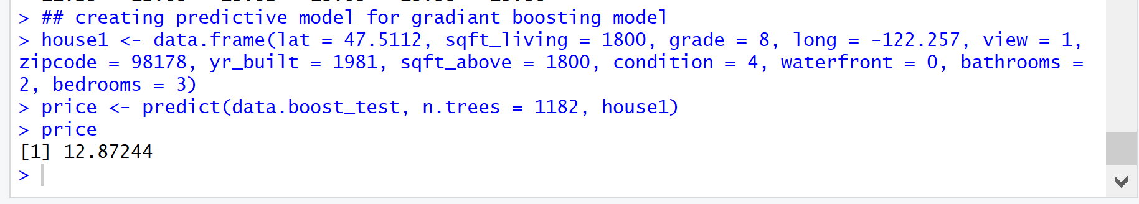
Stepwise regression and gradient boosting model [3]
Predictive model created for an accuracy >90% and number of iterations = 1,182 to prevent overfitting
Antilog value of 12.87244
Logarithmic equivalent – 388,481.2 (price of the house)
Difference of $89,885 from the original prediction

Slide 14
Conclusion
Model | Accuracy (%) | Price ($) | Difference ($)
Linear Model | 69.21 | 478,366.2 | 0
Optimized LM | 75.72 | 432,726 | 45,640.2 (9.55%)
GBM | > 90 | 388,481.2 | 44,244.8 (10.23%)
The location of the house, square footage of the house and the grade assigned to the house are the most influencing factors in predicting the price
Bedrooms and Bathrooms are not that influencing. E.g. 1BHK house in downtown area can be more expensive than 3BHK in suburbs
Due to high accuracy of the model, buyers can challenge the price quoted by local realtors if significant difference in the price structure.
Model can be used by buyers, sellers and management companies to have transparency in the pricing structure of a particular property
Due to general nature of variables, model can be used for other areas if data avaiable

Slide 15
Reference
Walia, A. (2018, February 16). Gradient Boosting in R. Retrieved from: https://datascienceplus.com/gradient-boosting-in-r/
Harlfoxem. (2016). House Sales in King County, USA. Retrieved from: https://www.kaggle.com/harlfoxem/housesalesprediction
Ridgeway, G. (2006, April 2016). Generalized Boosted Models: A guide to the gbm package. Retrieved from: http://ftp.auckland.ac.nz/software/CRAN/doc/vignettes/gbm/gbm.pdf
R Bloggers. (2013, February 5). Collinearity and stepwise VIF selection. Retrieved from: https://www.r-bloggers.com/collinearity-and-stepwise-vif-selection/

Slide 16
Questions? Thank You Mihir Gandhi gandhi.mih@husky.neu.edu

